Slide 1
Propositions & Offerings
The two layers of how Xomnia goes to market
PROPOSITION
OFFERING
“What do we stand for here,
and why does the market need us?”
“What exactly will you do for us,
how, and for how much?”
A named cluster of related capabilities that positions Xomnia in a specific market domain. It combines a clear point of view on a challenge with a coherent set of activities we bring to bear.
Strategic and durable: it shapes how we show up, how we talk about ourselves, and how we organise our teams. Xomnia has five propositions, each representing a distinct area of transformation value.
A packaged, deliverable answer to a specific customer need within a proposition. With a defined scope, a concrete approach, a clear team structure, a realistic timeline, and a commercial model.
Operational and repeatable: it can be scoped, priced, and sold. Multiple offerings can live under one proposition — together making it tangible and commercially executable.
1 : N
Strategic · Durable · Shapes positioning
Operational · Repeatable · Priced and sold
The commercial logic: build an offering once for one paying client — then replicate and sell it to many.

Slide 2
5 Strategic Choices
Building propositions & offerings for a Data & AI consultancy
01
02
03
04
05
Starting Point
Architecture
Value Chain Position
Productization
Market-Making
Inside-Out ↔ Outside-In
Horizontal ↔ Vertical
Advisory ↔ Build ↔ Run
Custom ↔ Packaged
Responsive ↔ Thought Leader
Capability-first builds menus. Problem-first builds propositions. Map offerings to client Jobs-to-be-Done, not your internal service taxonomy.
Broad capability across sectors vs. deep industry specialization. At boutique scale, hyper-specificity beats breadth on win rates and margin.
Strategy commands margin; managed services drives recurring revenue. Productize upward or integrate downward — each has a different risk profile.
Bespoke doesn't scale. Fixed scope, fixed price, named methodology. Packaged entry offers cut sales friction and create a natural pipeline.
Stake a distinctive point of view before the market names the problem. Clients who internalize your framing make you the default choice.
Felix · Strategic Frameworks · Data & AI Consultancy

Slide 3





We make AI work
03 | What we can do
01
02
03
04
05
Clear direction with AI
Agentic solutions in production
Intelligent Workflows
Modern Data Foundation
Trusted AI
AI mapped to business value, competitive advantage and investment thesis with executable roadmap
Agents, assets and connectors, from prototype to real impact with agent lifecycle management
Cross-functional workflow redesign, human-agent task allocation and orchestration
From legacy stack to AI-ready foundation, AI platforms and cloud infrastructure
EU AI Act compliance, accountability design and

Slide 4
Approach 01
- Industry agnostic

Slide 5
Our propositions and offerings
03 | What we can do
DRAFT
01
02
03
04
05
Agentic Strategy
Agentic solutions in production
Intelligent Workflows
Modern Data Foundation
Trusted AI
AI Board Brief board-ready narrative and investment case
AI Value Hunt top 5 use cases, sized and prioritized
Target Operating Model how to run AI at scale
Fractional AI leadership
AI business case investment case for your top 3 initiatives
MLOps maturity scan Assess current portfolio, processes & architecture
Model-to-Production sprint live, monitored, with a business owner
Agentic AI copilot delivery deployed for a named function (sales, service, legal, ops)
Predictive model accelerator churn, pricing, demand forecasting, fraud
MLOps foundation build tooling, pipelines, monitoring, retraining
AI cost optimization Improvement potential & recommendations
Automation opportunity scan Map & prioritise workflows ripe for agentic automation
Agentic workflow delivery a named business process, automated end-to-end
Document intelligence invoices, contracts, claims, onboarding paperwork
Contact center automation agentic customer service with live deflection metrics
Back-office process automation finance, HR, procurement workflows
Orchestration platform build buy vs build, integrated with existing stack
Data readiness assessment Scoring, target state and migration plan
Databricks rollout live platform with first workloads migrated
Lakehouse migration off legacy warehouse, onto modern Azure/AWS stack
Unity Catalog & data governance rollout
Data mesh implementation federated ownership, central standards
Platform cost optimization 30% TCO reduction, on average
EU AI Act audit ready for August 2026 compliance
EU / Sovereign Cloud migration
Open-source & EU LLM deployment / on-premise
Responsible AI framework policies, guardrails, model registry
AI risk & compliance audit

Slide 6
Approach 02
- Industry specific

Slide 7
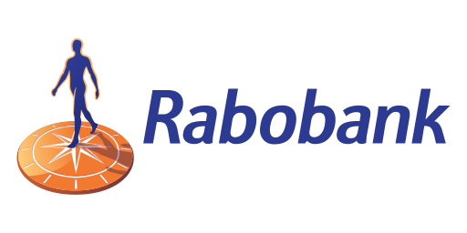






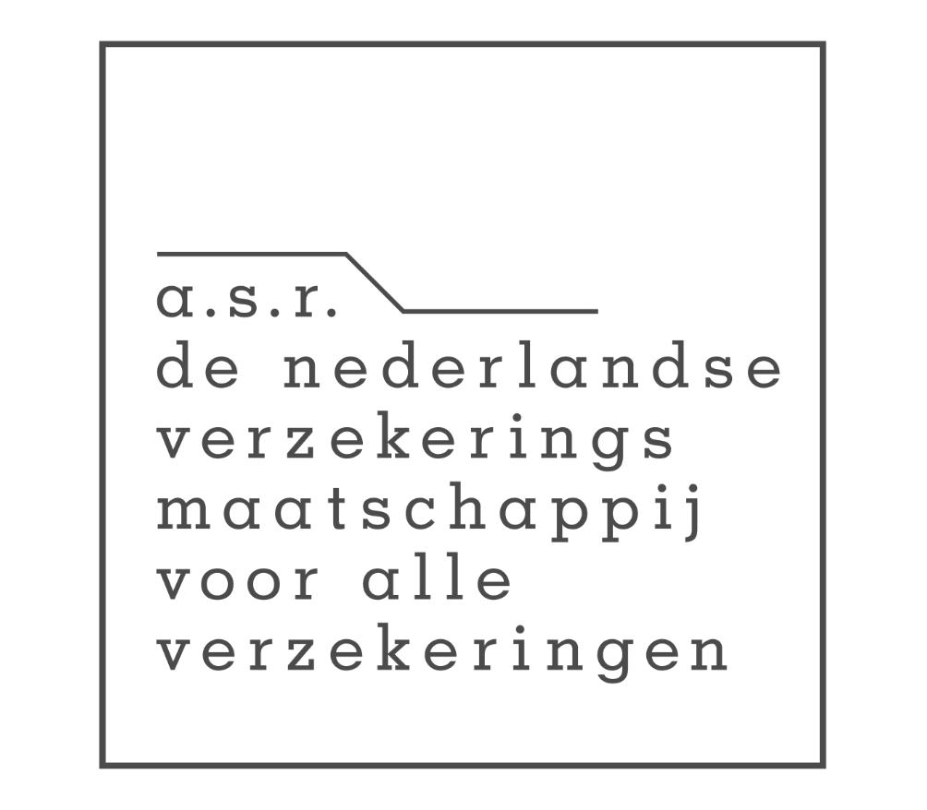

Financial Services
03 | What we can do
KEY OFFERINGS
We make AI work in…
Fraud & Transaction
Monitoring
Credit Risk &
Lending Engines
Real-time anomaly detection
Behavioural scoring, faster decisions
KYC / CDD
AI Agents
Regulatory Reporting
Automation
From data foundations to intelligent financial services
Scalable compliance automation
ESG, Solvency, risk pipelines
Risk & Scenario
Modelling
AI Assistants for
Financial Professionals
SUB-SECTORS
Explainable, audit-ready AI
Copilots, semantic search
▸ Banking
▸ Insurance
WE WORK WITH
▸ Asset Management
▸ FinTech
IMPACT
TECHNOLOGY ECOSYSTEM
Global
Automated
3 months
Azure · Databricks · Snowflake · AWS · Google Cloud
customer segmentation for Rabobank's transaction monitoring — sharper thresholds, full auditability
Solvency II & risk reporting for ASR: reduced errors, improved performance, scalable foundation
to production-ready GenAI platform at Nationale-Nederlanden — multi-tenant, secure, scalable

Slide 8







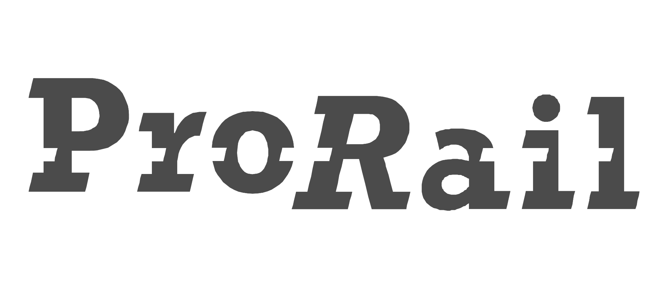




Energy, Utilities & Telco
03 | What we can do
KEY OFFERINGS
We make AI work in…
Predictive
Maintenance
Asset & Grid
Monitoring
Sensor data + time-series models
Real-time deviation detection
Grid Congestion
Management
Demand
Forecasting
From grid operations to AI-enabled critical infrastructure
Probability scores + action scenarios
Per customer, product & segment mix
GenAI Knowledge
Platform
Sovereign
Technology
SUB-SECTORS
Secure internal AI for operations
EU-based, open-source AI solutions
▸ Grid Operators
▸ Energy Companies
WE WORK WITH
▸ Telecom Providers
IMPACT
TECHNOLOGY ECOSYSTEM
98%
7,500
80–90%
Azure · Databricks · Snowflake · Polars · Open Source
cost reduction on Alliander's DELVI simulation pipeline after Polars migration
Enexis employees adopted GenAI knowledge platform — 4,000+ hours saved annually
accuracy in Enexis groundworks risk scoring — adopted by ~50% of field staff daily

Slide 9

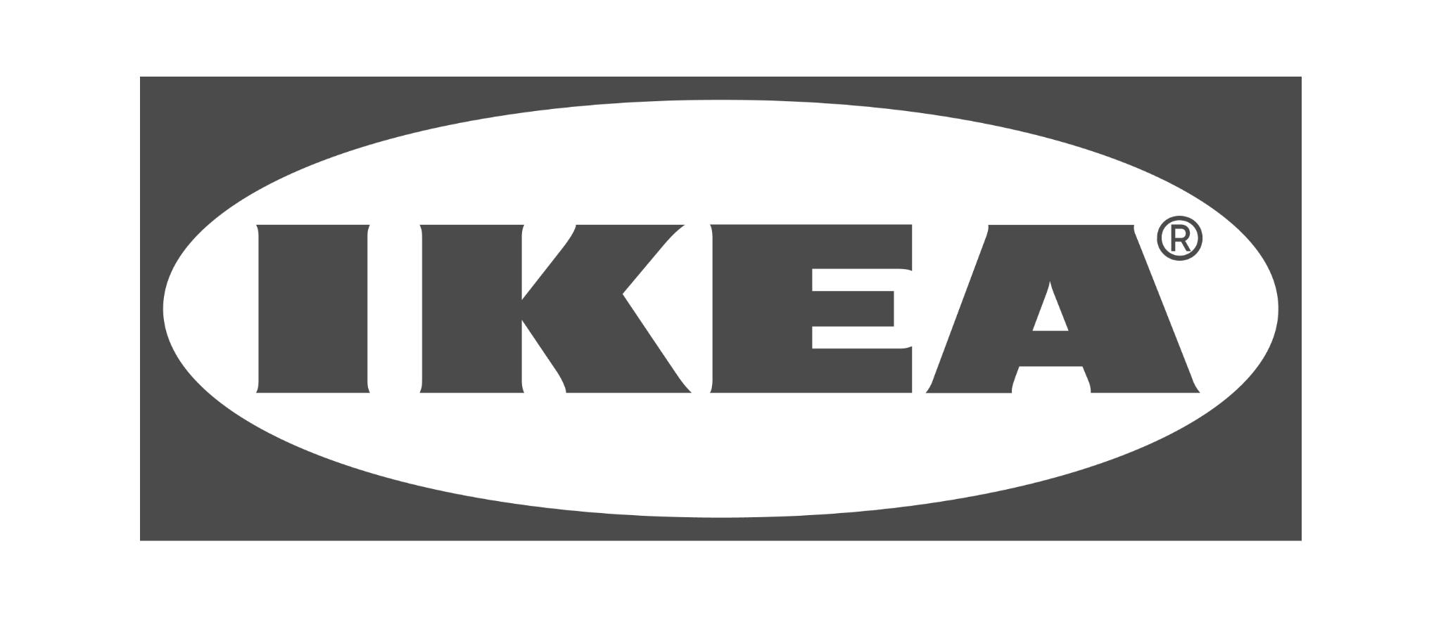





Consumer Products & Retail
03 | What we can do
KEY OFFERINGS
We make AI work in…
Demand Forecasting
Dynamic Pricing
& Promotions
SKU- and store-level, replenishment
Margin & volume optimization
Personalised
Recommendations
Customer Service
GenAI
From forecast to checkout — AI across the full retail value chain
Search, browse, email, in-store
RAG + agent assist, omnichannel
Inventory & Stock
Optimisation
Marketing Mix
& Attribution
SUB-SECTORS
Cut shortage and overstock
Causal models, incremental ROI
▸ Grocery & FMCG
▸ E-commerce
WE WORK WITH
▸ Omnichannel Retail
▸ Hospitality & Gaming
IMPACT
TECHNOLOGY ECOSYSTEM
88%
75%+
~50–60%
Azure / Fabric · Databricks · Google Cloud · Snowflake · Power BI
reduction in data preparation time for HEMA's marketing analytics team
fewer reports at Holland Casino, while overall BI platform usage increased
reduction in cart/checkout discrepancies at IKEA after Germany pilot fix

Slide 10


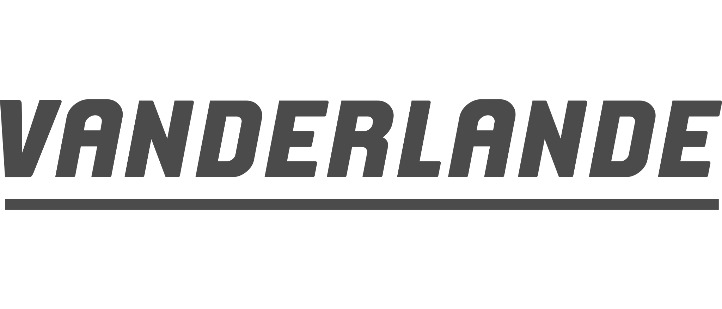





Transport & Logistics
03 | What we can do
KEY OFFERINGS
We make AI work in…
Predictive
Maintenance
Planning &
Scheduling Optimisation
Sensor-based failure prediction
Ground ops, fleet, resource allocation
Real-time
Operational Monitoring
IoT Data
Infrastructure
Data-driven operations across aviation, rail, road and logistics
Live dashboards and alerts
Edge-to-cloud data pipelines
Fleet Analytics
& Reporting
Capacity &
Delay Forecasting
SUB-SECTORS
Self-service, governed, scalable
ML models for traffic & runway
▸ Aviation
▸ Rail Infrastructure
WE WORK WITH
▸ Road Freight & Fleet
▸ Logistics & Warehousing
IMPACT
TECHNOLOGY ECOSYSTEM
37% / 46%
€2M
Real-time
Azure · Databricks · AWS · Kafka / Spark · Power BI
fewer arrival deviations and major delays at LVNL Air Traffic Control Netherlands
in prevented unplanned downtime annually at Vanderlande via IoT predictive maintenance
SSOT platform for DAF Used Trucks — automated pricing, AI-ready, pan-European

